Slide 1
Support Vector Machine

Slide 2
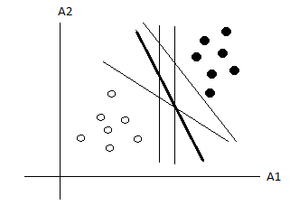
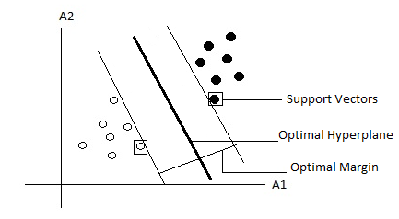
Support Vector Machine (SVM)
Determining the location of decision boundaries (hyperplane) that produce the optimal separation of classes among the infinite number of boundaries.
Optimal hyperplane – constructed by searching for maximal marginal hyperplane.
Margin – sum of distances to the hyperplane from the closest points of two classes.
Sides of margin are parallel

Slide 3
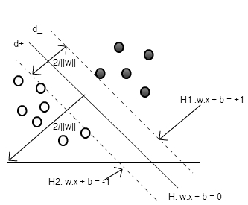
Linear SVM (Separable Case)
Let the Data set D be given as {x_{i}, y_{i}} , where x_{i} =1,2,.....,l (i.e. no. of samples or training tuples) and y_{i} {-1,1} and x_{i} ϵR^{d} .
the separating hyper plane satisfy the equation:

Slide 4

Linear SVM (Cont…)
W is the normal to the hyperplane, and the perpendicular distance from the hyperplane to the origin is
=
Any point that lies on or above the hyperplane satisfies the constraint
combined into one set of inequalities

Slide 5






Linear SVM (Cont…)
The distance of the bounding hyperplane H₁, from origin with normal w is,
Dist (H₁) = =
Similarly, the distance of the bounding hyperplane H₂, from the origin with normal w is
Dist (H₂) =
Therefore the margin or distance between two bounding hyperplanes is

Slide 6


Linear SVM (Cont…)
The margin of (w, b) is equal 2/||w||
Goal
Assuming given linearly separable training examples from two classes, the goal is to calculate the separating hyper-plane with maximum margin.
Objective function
Want to maximize 2/||w||, this is equivalent to minimizing which in turn is equivalent to minimizing

Slide 7

Linear SVM (Cont…)
Thus SVM solves the objective function
subject to constraint
This is the convex quadratic programming (QP) problem, which has a single global optimum solution.
Solved in dual space, the space of Lagrange multipliers

Slide 8

Linear SVM (Cont…)
The Lagrangian of this problem is given by
The Lagrange dual function of the optimization problem is given by
Differentiating the primal equation w.r.t. w & b and setting the derivatives equal to 0 gives

Slide 9






Linear SVM (Cont…)
Substituting this value in primal objective function, we get

Slide 10


Linear SVM (Cont…)
The dual problem now can be stated as:
Subject to
and
There is one to one relationship between each Lagrange multiplier and each training example.

Slide 11


Linear SVM (Cont…)
Karush-Kuhn-Tucker condition, which plays a central role in constrained optimization, for the above primal problem can be stated as
This conditions implies that coefficient(Lagrange multipliers) will be nonzero only when xi is a support vector.

Slide 12

Linear SVM (Cont…)
Solution:
bias b, can be computed using a positive SVs as.
compute bias b for optimal separating hyperplane as
The Classifier is then defined as

Slide 13
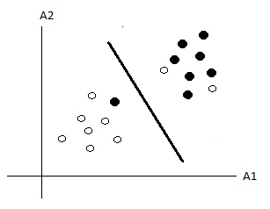
Soft Margin SVM
Non separable data – contains noisy data
Soft margin SVM allows mislabelled data points while still maximizing the margin.
Slack variables – measures the degree of misclassification

Slide 14
Soft Margin SVM (cont…)
The constraints will become
Combining them constraint becomes

Slide 15

Soft Margin SVM (cont…)
The objective function incorporating an extra cost for errors can be written as,
Subject to:
C is a regularization parameter that controls the trade-off between maximizing the margin & minimizing the training error term.

Slide 16

Soft Margin SVM (cont…)
Similar to linear SVM, the lagrangian of the primal form of objective function can be given as:
The solution of above equation is given by the saddle point of the Lagrangian as:

Slide 17



Soft Margin SVM (cont…)
substituting this values into primal form of objective function, the dual problem becomes
Subject to:
and

Slide 18
Soft Margin SVM (cont…)
KKT Conditions

Slide 19
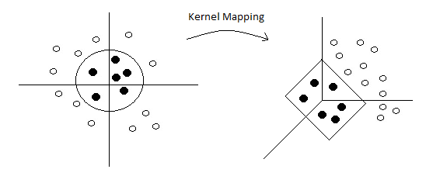
Non-linear SVM
2 steps
The input data (vectors) are transformed into high-dimensional feature space.
Use SVM to find the hyperplane of maximal margin in the new feature space.

Slide 20
Cover's theorem
Cover's theorem
A complex pattern-classification problem cast in a high-dimensional space nonlinearly is more likely to be linearly separable than in a low-dimensional space.
The power of SVMs resides in the fact that they represent a robust and efficient implementation of the principle in Cover's theorem on the separability of patterns.

Slide 21
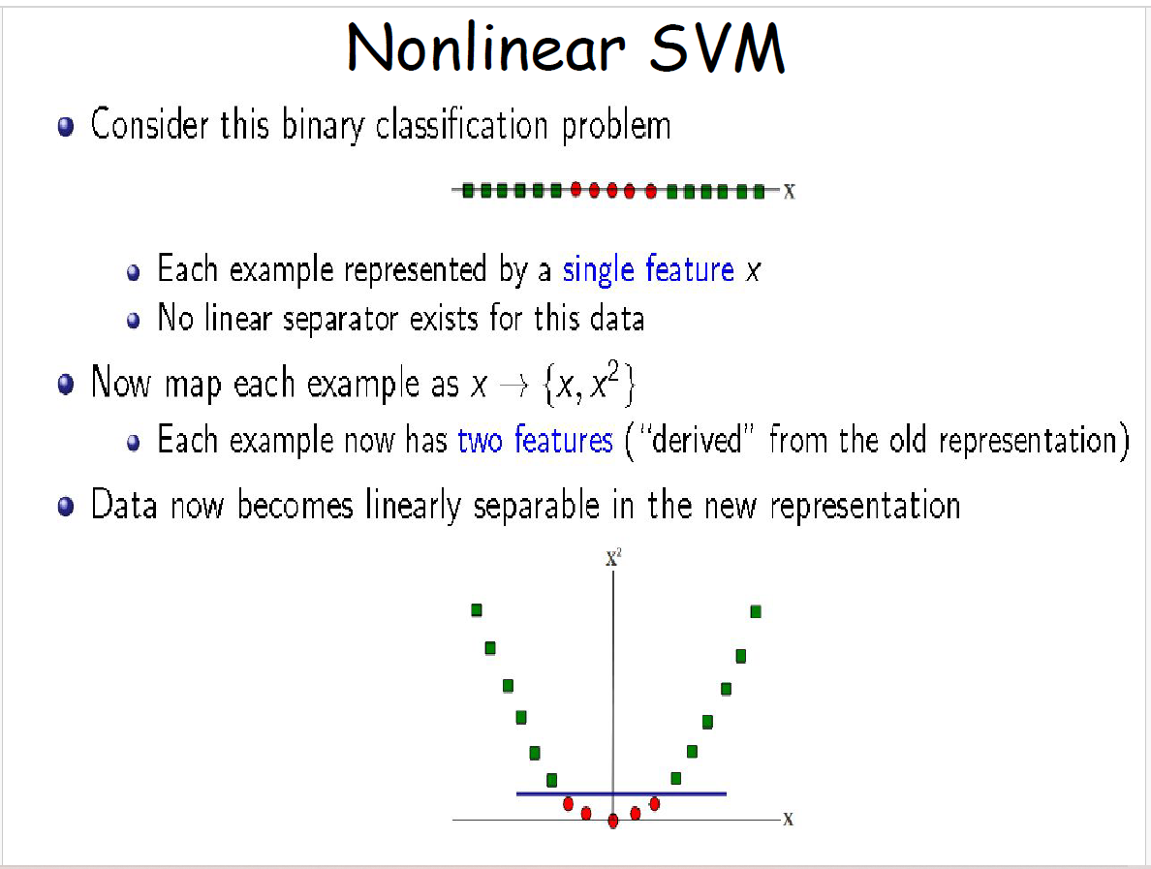

Slide 22
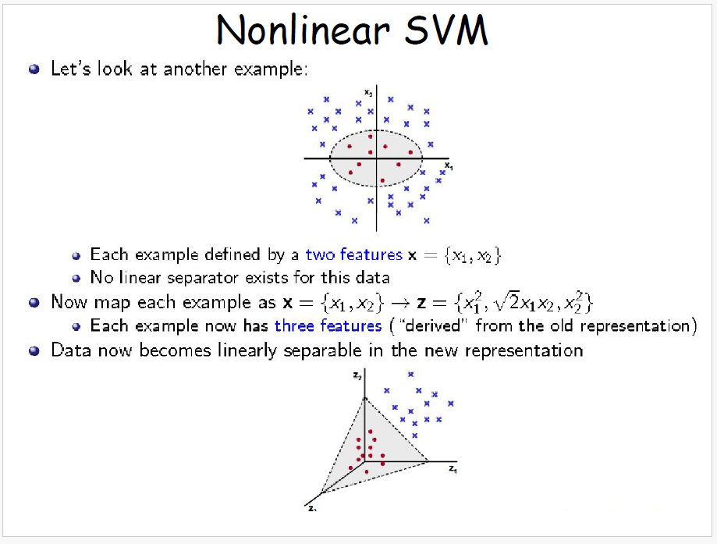

Slide 23
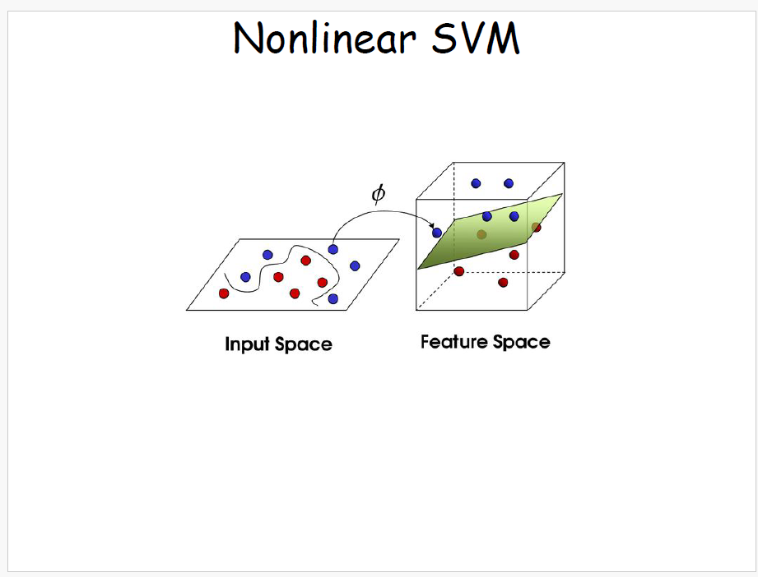

Slide 24
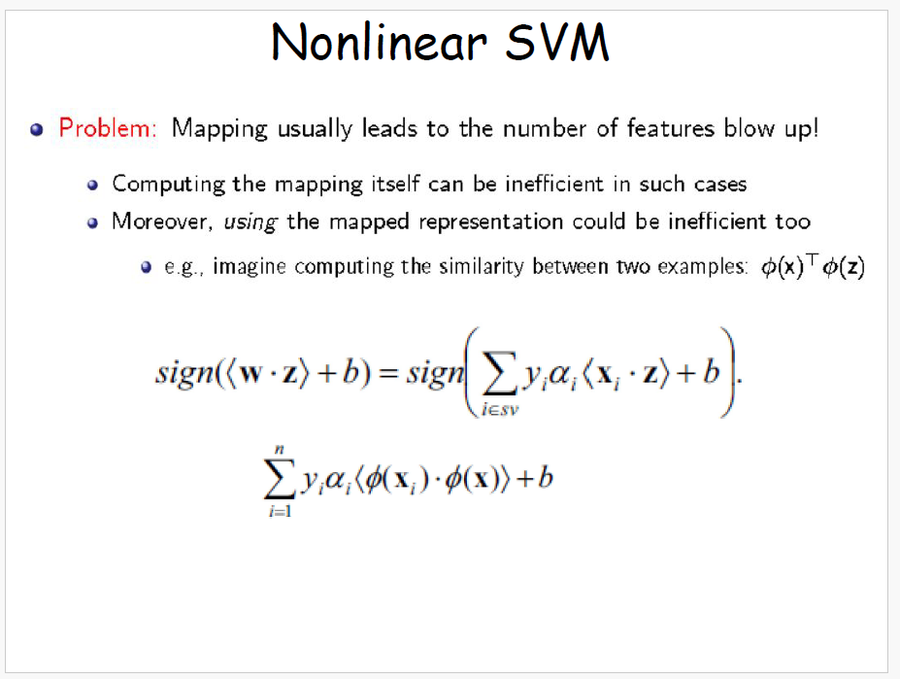

Slide 25
For example

Slide 26
After Tranformation

Slide 27
By the Transformations

Slide 28
After Transformation

Slide 29

Non-linear SVM
Let Ф be a nonlinear mapping function,
Where
With this transformation of data, the hyperplane representing decision boundary can be defined as
Using the Ф(.) function, the weight becomes

Slide 30


Non-linear SVM
The decision function becomes
And the dual problem can be rewritten as

Slide 31
Non-linear SVM(Cont…)
feature mapping function always appear as dot products
computing it in high or even infinite dimensional space
Complex
Costly
Suffer from curse of dimensionality

Slide 32

Non-linear SVM(Cont…)
E.g. let’s consider the cost function
Where
Assume that
The above objective function requires
n²/2 dot products to compute all .
Each dot product requires d²/2 additions and multiplications.
The whole thing requires n²d² /2 operations....

Slide 33
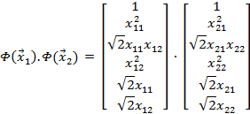
Non-linear SVM(Cont…)
Consider the two points
Let
Here,

Slide 34
Non-linear SVM(Cont…)
Instead of this if we consider,
In this case, if
n²/2 dot products to compute all .
Each dot product requires only (d+1) additions and multiplications.
The whole thing requires dn²/2 operations....

Slide 35
Kernel Functions
SVM learning requires only on the dot product Φ(x_{i}). Φ(x_{j})
between training examples as opposed to the individual Φ(x_{i})
application of an SVM to a novel feature vector x depends only on the dot product Φ(x_{i}). Φ(x) between x and the support vectors
Therefore, operations in high dimensional space do not have to be performed explicitly if we find a function such that
Here, Is called a kernel function in SVM terminology.

Slide 36


Kernel Functions (cont…)
Kernel function allows to calculate the dot product of (Φ(x_{i}), Φ(x_{j})) without explicitly applying function to input vector.
The dual problem is now defined using the kernel function as:
Subject to
and
The classification function becomes

Slide 37
Validity of Kernel Functions
A kernel function K is valid if there is some feature mapping Φ, such that
Mercer’s theorem proves that a kernel function is valid, if and only if the following condition is satisfied, for any function g(x)

Slide 38

Validity of Kernel
If K is a valid kernel, then the corresponding kernel matrix is
Symmetric
Positive (Semi-) definite, i.e. for any vector

Slide 39

Some well known Kernels
Linear Kernel
Polynomial Kernel
Radial Basis Function (RBF) Kernel
Sigmoid Kernel
Convex combinations of Kernels
Normalization Kernel

Slide 40
Advantages of SVM
The complexity of learned classifier is characterized by the number of support vectors rather than the dimension of data. Hence, SVM is less prone to overfitting compared to other classification methods.
The number of SVs found can be used to compute an upper bound on the expected rate of the SVM classifier, which is independent of data dimensionality.
It has good generalization capability by maximizing the margin in input space.

Slide 41
Example of SVM
Example 1: (with linear kernel)
Example 2: ( with polynomial kernel)

Slide 42
Motivation of Analysis
The memory requirement of SVM is grows with the squares of number of training examples, so scaling SVM for large dataset is one of the challenging issue.
Computationally expensive as SVM’s training time scales quadratically in the number of examples.
The underlying model implemented in SVMs is determined by the choice of the kernel. Deciding which kernel is the most suitable for a given application is obviously an important and open issue.
SVM outputs are not user friendly.
SVMs were developed to perform binary classification. Need to develop multiclass SVMs, because most of the classification problems involve more than two classes.

Slide 43
Decomposition Based Methods
Method Used | SVM type | Algorithm | Proposed By | Year
Decomposition Based Methods (batch learning) | kernel | Chunking [16][17] | Vapnik | 1998
 | kernel | [18] SVM^{light} | T. Joachims | 1999
 | kernel | SMO [14] [17] | J. Platt | 1999
 | kernel | Alpha Seeding [18] | De Coste and Wagstaff | 2000
 | kernel | LIBSVM [18] | Hsu and Lin | 2002
 | kernel | SimpleSVM [19] | Vishwanathan et al. | 2003
 | kernel | CVM (Core Vector Machine) [20] | Ivor W.Tsang, James T. Kwok, Pak-Ming Cheung. | 2005
 | kernel | LASVM (large scale SVM) [21] | Antoine Bordes | 2005
 | kernel | BVM (Ball vector machine) [22] | Tsang et al. | 2007
 | kernel | SVM+MEB [23] | Jair Cervantes, xiabou Li, Web Yu, Kang Li | 2007
 | kernel | LLSVM (Low rank linearization approach) [24] | Zhang et al. | 2012
 | kernel | AESVM (Approximate extreme points SVM) [25] | Manu Nandan, Pramod P. Khargonekar, Sachin S. Talathi | 2013

Slide 44
Decomposition Based Methods
Research Findings:
solve a sub-problem of few variables at each iteration.
Only a small number of corresponding kernel columns are needed, so the memory problem is resolved.
Gives good generalization performance.
For linear SVM decomposition methods are inefficient as they are time consuming.

Slide 45
Gradient Based Methods
Method Used | SVM type | Algorithm | Proposed By | Year
Gradient Based Method (online algorithms) | kernel | IDSVM (Incremental and Decremental SVM) [26] | Cauwenberghs, Poggio | 2000
 | kernel | NORMA [27] | J. Kivinen, A. J. Smola, and R. C. Williamson | 2002
 | Linear | SGD (Stochastic Gradient Algorithm) [26] | Zhang | 2004
 | Linear | SVMperf[18][27] | Thorsten Joachims, Thomas Finley, and Chun-Nam John Yu | 2006
 | kernel | Pegasos (Primal Estimated sub-GrAdient Solver for SVM) [27] | Shalev-Shwartz, Yoram Singer, Nathan Srebro | 2007
 | Linear | OCAS (Optimized Cutting Plane Algorithm for SVM) [28] | Franc and Sonnenburg | 2008
 | Linear | (LibLinear )A Dual Coordinate Descent Method for Large-scale Linear SVM [28] | Hsieh, Chang, Lin, Keerthi, Sundararajan | 2008
 | Linear | Bundle Method for Risk Minimization (BMRM) [28] | Choon Hui Teo, Quoc Le, Alex Smola, Vishwanathan | 2007
 |  |  | Teo et al. | 2010
 | kernel | TVM (Twin prototype SVM) [28] | Wang, Vueetic | 2010b
 | kernel | COFFIN (A Computational Framework for Linear SVMs) [29] | Sonnenburg and Franc | 2010
 | kernel | Budget SGD [26] | Zhuang Wang, Koby Crammer, Slobodan Vucetic | 2012

Slide 46
Gradient Based (Online learning) Method:
Research Findings:
Used for linear SVM, in which number of variable selected in each iteration is restricted to one.
when equipped with the kernel function causes unbounded linear growth in model size and update time with data size.
Some of the methods are able to handle large scale data with speeding training time using parallelism, but they are proposed for only binary classification.
Also, they focus only on time to run data in memory, but not on time required to load data in memory.

Slide 47
Block Minimization Method
Method Used | SVM type | Algorithm | Proposed By | Year
Block Minimization Method (batch learning) | Linear | large linear classification when data cannot fit in memory [32] | Hsiang-Fu Yu, Cho-Jui Hsieh, Kai-Wei Chang, Chih-Jen Lin | 2010
 | Linear | SBM ( Selective Block Minimization) [33] | Chang and Ron | 2011
Research Findings:
considers both time: time to run data in memory + time to load data in memory for considering the training time.
This methods are proposed for linear classifications and handles multi classification, but may be more costlier when applied to nonlinear kernel, as disk I/O are expensive.

Slide 48
Variant Based Methods
Method Used | SVM type | Algorithm | Proposed By | Year
Variant Based Methods | Linear | LS-SVM (least squared svm) [18] | J.Suykens and J.Vandewalle | 1999
 | Linear | LP-SVM [18] | Bradley and Mangasarian | 2000
 | Linear | LSVM (Lagrangian svm) [18] | Mangasarian abd Musicant | 2001
 | Linear | PSVM (Proximal SVM) [18] | Fung and Mangasarian | 2001
 | kerenel | RSVM (Reduced SVM) [18] | Lee and Mangasarian | 2001
Research Findings
This methods have been proposed for speedup of SVM, at the price of accuracy.

Slide 49
Multiclass Based Methods
Method Used | SVM type | Algorithm | Proposed By | Year
Multiclass Based Methods | kernel | Error Correcting Codes [30] | T. G. Dietterich and G. Bakiri | 1995
 | kernel | OVO (one-agains-one) [30] [31] | J. Friedman | 1996
 | kernel | OVA (one- Against-all) [30][31] | V. Vapnik | 1998
 | kernel | DAGSVM [31] | Platt | 2000
 | kernel | MSVM (Multistage SVM) [30] | X. Liu, H. Xing, X. Wang | 2003
 | kernel | HSVM (Hierarchical svm) [30] | Yangchi Chen, M. Crawford, J. Ghosh | 2004
 | kernel | BTS (Binary tree of SVM) [31] | B. Fei, J. Liu | 2006
 | kernel | SVM-BDT [31] | Gjorgji Madzarov, Dejan Gjorgjevikj, Ivan Chorbev | 2009

Slide 50
Multiclass Based Methods
Research Findings:
Multiclass classification problem can be decomposed into several binary classification tasks that can be solved efficiently using binary classifiers. This type of methods required large memory during training phase and may be slower in testing phase.
Other Findings:
There is no fixed rule in the choice of kernel function. For different application different kernel functions proved to be better.
Selecting the parameter of kernel functions is challenging task.
Feature selection algorithm reduces the size of the data which reduce the training time with accuracy converges to the state-of-the art SVM
None of the above method is concentrated on the interpretation of result or post processing

Slide 51
Initial Hypothesis
“Propose a new learning algorithm which is able to fulfil one or more of the following criteria”:
Reduce the training as well as testing time and should be scalable for large data set.
Should preserve the accuracy of SVM or increase the accuracy.
Should be generalize to handle binary as well as multi classification.
Generalized kernel which can be applicable to any application.
Result generated should be interpretable by user.

Slide 52
References
V. N. Vapnik “An Overview of Statistical Learning Theory”, IEEE Transactions on Neural Networks, vol. 10, no. 5, September 1999
O. Bousquet, S. Boucheron, and G. Lugosi, “Introduction to Statistic Learning Theory”, Advanced Lectures on Machine Learning, Springer Berlin Heidelberg, 2004. 169-207
U. Luxburg and B. Scholkopf, “Statistic Learning Theory: Model ,Concepts and Results” by Handbook of the history of logic © 2009 Elsevier
S. R. Kulkarni and G. Harman, “ Statistical Learning Theory: A Tutorial”, February 20, 2011
V. Vapnik, C. Cortes, “Support Vector Network,” Machine Learning, vol. 20, pp. 273-297,1995
C. J. Burges, "A Tutorial on Support Vector Machines for Pattern Recognition," Data Mining and Knowledge Discovery, vol. 2, 1998.
V. Vapnik, “Statistical Learning Theory”, Wiley India Pvt. Ltd., 2011

Slide 53
References (cont…)
J. Han and M. Kamber, “Data Mining Concepts and Techniques”, Elevier, 2011.
K.P.Sonam, S. Diwakar, V. Ajay,”Insight into Data Mining Theory and Practice”, PHI, 2006.
H. Yu and S. Kim, “SVM tutorial : classification, regression, and ranking”, Handbook of Natural Computing, 2009.
R. Burbodge, B. Buxton, “An introduction to Support Vector Machines for Data Mining,” Computer Science Dept., UCL, UK..
A. M. Javier ,M. Moguerza, “Support Vector Machines with Applications,” Statistical Science , vol. 21, no. 3, pp. 322-336, 2006.
Huson, “SVM and Kernel functions”, Algorithms in Bioinformatics II, SoSe’07, ZBIT, D., June 27, 2007.
R. Chattamvelli, “Data Mining Algorithms”, published by Narosa Publishing House Pvt. Ltd., ISBN 978-81-8487-120-3, 2011.

Slide 54
References (cont…)
R. Sood and S. Kumar,” The effect of Kernel function on Classification”, XXXII National Systems Conference, NSC 2008, Dec 17-18, 2008.
K. Muller, S. Mika, G. Ratsch, K. Tsuda, B. Scholkopf, “An Introduction to Kernel-Based Learning Algorithms”, IEEE transactions on Neural Networks, Vol. 12, No. 2, March -2001.
J. Platt. Fast training of support vector machines using sequential minimal optimization. Advances in Kernel Methods - Support Vector Learning, MIT Press, 1998.
G. Wang, S.Z., Y. San “ A Survey on Training Algorithms for Support Vector Machine”. CAAI Transactions on Intelligent Systems3, no. 6, 467-475, 2008.
S. V. N. Vishwanathan, A. J. Smola, and M. N.Murty. “Simplesvm”. In International Conference onMachine Learning, 2003.
W. Tsang, J. T. Kwok, and P.-M. Cheung. “Core vector machines: fast svm training on very large data sets”, Journal of Machine Learning Research, 2005.
A. Bordes, S. Ertekin, J. Weston, and L. Bottou. “Fast kernel classifiers for online and active learning”, Journal of Machine Learning Research, 2005.

Slide 55
References (cont…)
I. W. Tsang, A. Kocsor, and J. T. Kwok. “Simpler core vector machines with enclosing balls”, In International Conference on Machine Learning, 2007.
J. Cervantesa, X. Lia, W. Yub, Kang Lic, “Support vector machine classification for large data sets via minimum enclosing ball clustering”, Neurocomputing 71 611–619, 2008.
K. Zhang, L. Lan, Z. Wang, and F. Moerchen. Scaling up kernel svm on limited resources: a lowrank linearization approach. In International Conference on Artificial Intelligence and Statistics, 2012.
M. Nandan, Pqa. P. Khargonekar, S. S. Talathi, “Fast SVM Training Using Approximate Extreme Points”, arXiv preprint arXiv: 1304.1391.
Z. Wang, K. Crammer, S. Vucetic, “Breaking the Curse of Kernelization: Budgeted Stochastic Gradient Descent for Large-scale SVM training”, Journal of Machine Learning Research 13, 2012, 2903-2931.
Shalev-Shwartz, Y. Singer, N. Srebro, and A. Cotter. “ Pegasos: primal estimated sub-gradient solver for svm”, In proceedings of 24th International Conference on Mathematical learning, 807-814, ACM, 2007
A. Menon, “Large-Scale Support Vector Machines: Algorithms and Theory”, Research Exam, University of California, San Diego, 2009

Slide 56
References (cont…)
Sonnenburg and V. Franc. “Coffin: a computational framework for linear svms”. In International Conference on Machine Learning, 2010.
H. Bhavsar, A. Ganatra, “Variations of Support Vector Machine Classification Technique: A survey”, International Journal of Advanced Computer Research, ISSN: 2249-7277, Vol. 2, No. 4, issue 6, Dec. 2012.
D. G. Gjorgji Madzarov, “ A Multi-class SVM Classifier Utilizing Binary Decision Tree”. Informatica , pp. 233-241, 2009.
H. Yu, C. Hsieh, K. Chang, C. Lin, “large linear classification when data cannot fit in memory”, Journal ACM Transactions on Knowledge Discovery from Data (TKDD), Volume 5 Issue 4, article No. 2, Feb 2012.
K. Chang and D. Roth, “Selective block minimization for faster convergence of limited memory large-scale linear models”, in KDD’11 proceedings of the 17th ACM SIGKDD international conference on knowledge discovery and data mining, pages 699-707, 2011.
T. Wang, “Improving SVM Classification by Feature Weight Learning”, International Conference on Intelligent Computation Technology and Automation, 2010.

Slide 57
Thank you

